Slide 1

MPI
Moving to more than one machine

Slide 2
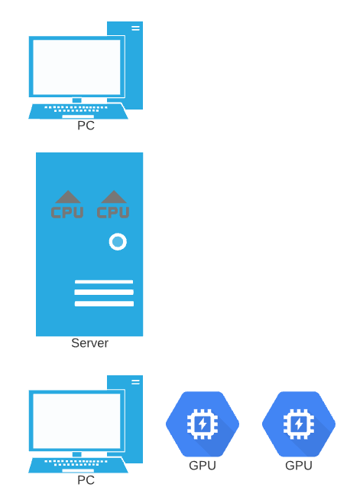
Quick Recap
We started with multiple process and threads – all on the CPU core(s).
Then we moved to the vector processing on the CPU.
Finally, we moved across the PCI Express bus to the GPU(s).

Slide 3
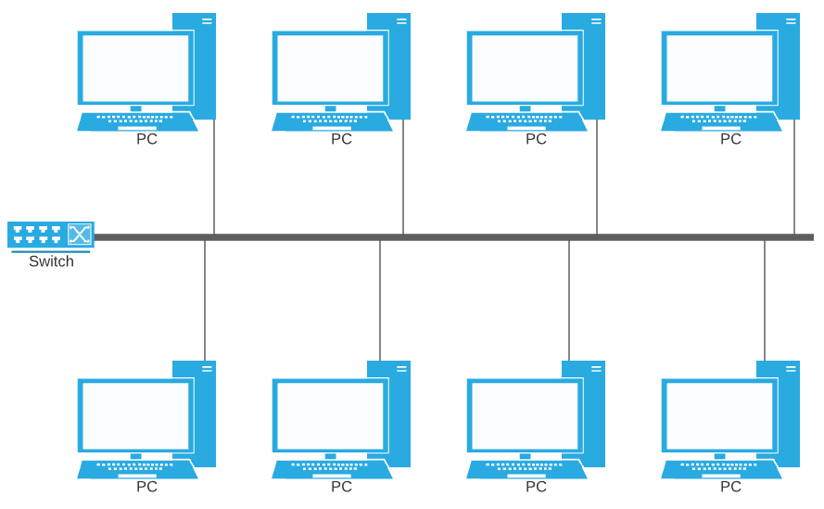
What about multiple machines?

Slide 4
MPI – The Message Passing Interface
“The goal of the Message Passing Interface, simply stated, is to develop a widely used standard for writing message-passing programs. As such the interface should establish a practical, portable, efficient, and flexible standard for message passing.”

Slide 5
Why Message Passing?
As we saw with GPUs, accessing RAM on a byte (or word) basis is very slow across a bus or a network. So much so that NVIDIA doesn’t even allow it.
Consider a mental model of sending a big batch of math problems through the mail to another person who will do those problems. This is much more efficient then having them you mail them one at a time.

Slide 6
How does this work?
You write one program and compile it.
You use a “launcher” – a program that “knows” what machines are available to run on.
The launcher copies your program over the network to some/all the other machines and runs it there.
The launcher can also run multiple copies of your program on some/all the machines if they have multiple cores.

Slide 7
Compiling your code
Much like with CUDA we used nvcc, here we will use mpicc.
This is usually a wrapper around gcc, but it takes care of compiling and linking in the MPI libraries.
Example:
mpicc –o helloWorld mpi_hello_world.c

Slide 8
#include <mpi.h>
#include <stdio.h>
int main(int argc, char** argv) {
MPI_Init(NULL, NULL); // Initialize the MPI environment
int world_size;
MPI_Comm_size(MPI_COMM_WORLD, &world_size); // Get the number of processes
int world_rank;
MPI_Comm_rank(MPI_COMM_WORLD, &world_rank); // Get my process number
char processor_name[MPI_MAX_PROCESSOR_NAME];
int name_len;
MPI_Get_processor_name(processor_name, &name_len); // Get machine name
printf("Hello world from processor %s, rank %d out of %d processors\n", processor_name, world_rank, world_size);
MPI_Finalize(); // Finalize the MPI environment.
}

Slide 9
#include <mpi.h>
#include <stdio.h>
int main(int argc, char** argv) {
MPI_Init(NULL, NULL); // Initialize the MPI environment
int world_size;
MPI_Comm_size(MPI_COMM_WORLD, &world_size); // Get the number of processes
int world_rank;
MPI_Comm_rank(MPI_COMM_WORLD, &world_rank); // Get my process number
char processor_name[MPI_MAX_PROCESSOR_NAME];
int name_len;
MPI_Get_processor_name(processor_name, &name_len); // Get machine name
printf("Hello world from processor %s, rank %d out of %d processors\n", processor_name, world_rank, world_size);
MPI_Finalize(); // Finalize the MPI environment.
}
Which “subgroup” to communicate with.
The whole defined network, in this case

Slide 10
How do we send and receive data?
MPI_Send(
void* data, // pointer to the data
int count, // number of data items
MPI_Datatype datatype, // data type
int destination, // who (rank) is to receive the data
int tag, // an indicator to the destination of what this data is for
MPI_Comm communicator) // the “group” that I want to potentially send this data to
MPI_Recv(
void* data, // pointer to the data buffer
int count, // maximum number of data items
MPI_Datatype datatype, // the data type
int source, // who (rank) will be sending me data
int tag, // which data I am looking for
MPI_Comm communicator, // the “group” I expect the data from
MPI_Status* status) // Info about the received message

Slide 11
MPI Data Types
MPI datatype | C equivalent
MPI_SHORT | short int
MPI_INT | int
MPI_LONG | long int
MPI_LONG_LONG | long long int
MPI_UNSIGNED_CHAR | unsigned char
MPI_UNSIGNED_SHORT | unsigned short int
MPI_UNSIGNED | unsigned int
MPI_UNSIGNED_LONG | unsigned long int
MPI_UNSIGNED_LONG_LONG | unsigned long long int
MPI_FLOAT | float
MPI_DOUBLE | double
MPI_LONG_DOUBLE | long double
MPI_BYTE | char

Slide 12
What if I don’t care about sender and tag?
MPI_ANY_SOURCE and MPI_ANY_TAG
How do I find out what they were when I didn’t ask in the receive?
status.MPI_SOURCE
status.MPI_TAG
Count?
MPI_Get_count(status, datatype, &count) // how many for this data type did we receive?

Slide 13

Probe?!?
We can “ask” what messages are “out there” before accepting them.
MPI_Probe(int source, int tag, MPI_Comm comm, MPI_Status *stat)
It’s just like “MPI_Recv” except that it doesn’t accept the message.

Slide 14
Send and Receive are blocking
Send will wait until the message has been copied somewhere safe. That could be the destination, or it could be a system buffer – you can’t tell.
Receive will wait, preventing any other code from running, until it finds a message that matches the source and tag specifications.
Note – the tags are completely arbitrary and defined by your program. The source/destination are ranks.
Non-blocking versions of both send and receive exist but are complex by comparison.

Slide 15
Broadcast
In many cases, you want to send to a particular node. For example – maybe node 0 reads all the data from disk and sends some to nodes 1,2 and 3. But sometimes you want to broadcast a message to everyone.
int MPI_Bcast(void *buffer, int count, MPI_Datatype dt, int root, MPI_Comm comm);
root selects which process is sending the message.
Example use: We want to abort the calculation on all machines.

Slide 16
Reduce
Just as we saw in OpenMP, a reduce method can save us a lot of data transmission.
int MPI_Reduce(void *sendBuf, void *recvBuf, int count, MPI_Datatype dt, MPI_Op op, int root, MPI_Comm comm)
Each processes uses the same count, datatype, operation, root and comm. The operation is done on all elements of the sendBuf and then transferred, combined to root’s recvBuf.

Slide 17
MPI_OP
Name | Meaning
MPI_MAX | maximum
MPI_MIN | minimum
MPI_SUM | sum
MPI_PROD | product
MPI_LAND | logical and
MPI_BAND | bitwise and
MPI_LOR | logical or
MPI_BOR | bitwise or
MPI_LXOR | logical xor
MPI_BXOR | bitwise xor

Slide 18
Much more
Everything that you need to write many good applications has been discussed. There is much, much more to learn, however.
See the MPI-Forum here: https://www.mpi-forum.org/
for official documentation and more details on everything!

